Slide 1
Software Applications
system software
application software
engineering/scientific software
embedded software
product-line software
WebApps (Web applications)
AI software

Slide 2
Software (New Categories)
Open world computing—pervasive, distributed computing
Ubiquitous computing—wireless networks
Netsourcing—the Web as a computing engine
Open source—”free” source code open to the computing community (a blessing, but also a potential curse!)
Also
  Data mining
  Grid computing
  Cognitive machines
  Software for nanotechnologies

Slide 3
Legacy Software
The older programs which are developed decades ago that are still in use by performing modifications in order to meet the business requirements.
Why must it change?
  software must be adapted to meet the needs of new computing environments or technology.
  software must be enhanced to implement new business requirements.
  software must be extended to make it interoperable with other more modern systems or databases.
  software must be re-architected.

Slide 4
Software Process

Slide 5
Process
What is it?
  A series of predictable steps
  A roadmap that helps create a timely, high-quality result
Who does it?
  Software Engineers and their managers adopt it their needs
  Users play a role in the process of defining, building and testing

Slide 6
Process
Why is it important?
  It provides stability, control, and organization to an activity
  Uncontrolled activity becomes quite chaotic
  Modern software engineering approach must be “agile”
    Demand only those activities, controls and documentation that are appropriate for the project team and the product
What are the steps?
  The process that you adopt depends on the software that you’re building

Slide 7
Process
What is the work product?
  The programs, documents, and the data that are produced as a consequence of the activities and tasks defined by the _________
How do I ensure that I’ve done it right?
  There are number of software process assessment mechanisms
  These enable an organization to determine the “maturity” of the process
  The quality, timeliness, and long term viability of the product are the best indicators of the efficiency of the process

Slide 8
Process
What is a software process?
  A framework for the tasks that are required to build high quality software
  Is process synonymous with software engineering?
  The process defines the approach taken as software is engineered
  Software engineering also encompasses
    Technical methods and automated tools
The answer is yes and no. a software process defines the approach that is taken as software is engineered. But software engineering also encompasses technologies that populate the process---- technical methods and automated tools.
More important, software engineering is performed by creative, knowledgeable people who should adapt a mature software process that is appropriate for the products they build and the demands of their marketplace.

Slide 9
Layered Technology
Software Engineering
tools
methods
process model
a “quality” focus

Slide 10
Layered Technology
A quality focus
  Any engineering approach must rest on an organizational commitment to quality.
  Foster a continuous process improvement culture
Process
  Glue – holds the technology layers together
  Foundation for software engineering
  Enables timely development

Slide 11
Layered Technology
Process (continue)
  Forms the basis for management control of software projects
  Establishes the context in which technical methods are applied
  Work products are produced
  Milestones are established
  Quality is ensured
  Change is properly managed
Methods
  Provide the technical “how to’s” for constructing software

Slide 12
Layered Technology
Methods (continue)
  Tasks include communications, requirement analysis, design modeling, program construction, testing, and support.
  Rely on set of basic principles
    To govern each area of the technology
    Include modeling activities
Tools
  Automated or semi-automated support for the process and methods

Slide 13
Process Framework
Process framework
  Framework activities
    work tasks
    work products
    milestones & deliverables
    QA checkpoints
  Umbrella Activities

Slide 14
Process Framework
A process framework
  Establishes the foundation for a complete software process
    Identifies a small number of framework activities that are applied to all software projects regardless of the size and complexity
  Encompasses a set of umbrella activities that are applicable across the entire software process
  “A process defines who is doing what, when, and how to reach a certain goal.”

Slide 15
Framework Activities
Communication
Planning
Modeling
  Analysis of requirements
  Design
Construction
  Code generation
  Testing
Deployment

Slide 16
Framework Activities
Communication
  This activity involves heavy communication and collaboration with the customer
    Requirement gathering and other related activities
Planning
  This activity establishes a plan for the software engineering work that follows
  Describes technical tasks to be conducted, the risks that are likely, the resources that will be required, the work products to be produced, and a work schedule

Slide 17
Framework Activities
Modeling
  This activity involves creation of models that allow the developer and customer better understand software requirements and design that will achieve those requirements.
    Analysis (action)
      Work tasks (Requirement gathering, elaborations, negotiation, specification, and validation)
    Design (action)
      Work tasks (data design, architectural design and interface design)

Slide 18
Framework Activities
Construction
  This activity combines code generation and the testing that is required to uncover errors in the code
Deployment
  Deployment of software
    Complete entity or partially completed increments
    Customer feedback

Slide 19
Umbrella Activities
Software project management
Formal technical reviews
Software quality assurance
Software configuration management
Work product preparation and production
Reusability management
Measurement
Risk management

Slide 20
Umbrella activities
Software project tracking and control
  Assess progress against the project plan
  Maintain schedule
Risk management
  Assess risks that may affect outcome and quality of the project
Software quality assurance
  Defines and conducts activities required to ensure software quality

Slide 21
Umbrella activities
Formal technical reviews
  Assess software engineering work products in an effort to uncover and remove errors before they are propagated to the next action or activity
Measurement
  Defines and collects process, project, and product measures that assist the team in delivering software that meets customer needs
Software configuration management
  Manages the effect of change throughout the software process

Slide 22
Umbrella activities
Reusability management
  Defines criteria for work products reuse
  Establishes mechanism to achieve reusable components
Work product preparation and production
  Activities required to create work products such as models, documents, logs, forms and lists

Slide 23
The Process Model:
Adaptability
the framework activities will always be applied on every project ... BUT
the tasks (and degree of rigor) for each activity will vary based on:
  the type of project
  characteristics of the project
  common sense judgment; concurrence of the project team

Slide 24
The Process Model:
Adaptability
Process models do differ fundamentally
  The overall flow of activities and tasks
  Interdependencies among activities and tasks
  The degree to which
    work tasks are defined within each framework activity
    work products are identified and required
    Detail and rigor with which the progress is described
    Customer and other stakeholders are involved
    Team organization and roles are prescribed

Slide 25
The Process Model:
Adaptability
Process models do differ fundamentally
  The manner in which
    quality assurance activities are applied
    project tracking and control activities are applied
Intent is to
  Improve software quality
  Make projects more manageable
  Make delivery dates
  Costs more predictable
  Guide teams of software engineers

Slide 26
CMMI
The CMMI (The Capability Maturity Model Integration) defines each process area in terms of “specific goals” and the “specific practices” required to achieve these goals.
Specific goals establish the characteristics that must exist if the activities implied by a process area are to be effective.
Specific practices refine a goal into a set of process-related activities.

Slide 27
CMMI Level
Level 0 (Incomplete) –
  Process are not performed or not achieve all the goals and objectives defined by the CMMI for Level I capability.
Level 1 (Performed) – All specific goals are performed as per defined by
CMMI
Level 2 (Managed) –
  All level 1 criteria have been satisfied
  In addition to Level I;
    People doing work have access to adequate resources to get job done,
    Stakeholders are actively involved,
    Work tasks and products are monitored, controlled, reviewed, and evaluated for conformance to process description.
Level 3 (Defined) –
  All level 2 criteria have been achieved.
  In addition;
    management and engineering processes documented
    standardized and integrated into organization-wide software process

Slide 28
CMMI Level (cont.)
Level 4 (Quantitatively Managed) -
  All level 3 criteria have been satisfied.
  Software process and products are quantitatively understood
  Controlled using detailed measures and assessment.
Level 5 (Optimized) –
  Continuous process improvement is enabled by quantitative feedback from the process and testing innovative ideas.

Slide 29
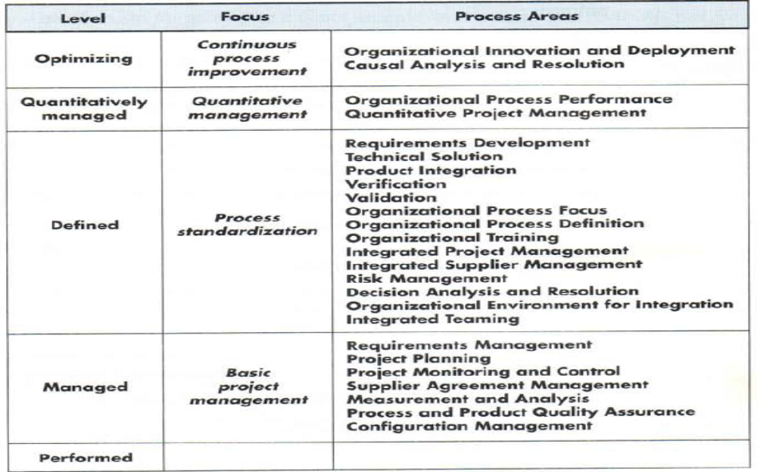

Slide 30
Process Patterns
Process patterns define a set of activities, actions, work tasks, work products and/or related behaviors
A template is used to define a pattern
Typical examples:
  Customer communication (a process activity)
  Analysis (an action)
  Requirements gathering (a process task)
  Reviewing a work product (a process task)
  Design model (a work product)

Slide 31
Process Assessment
The process should be assessed to ensure that it meets a set of basic process criteria that have been shown to be essential for a successful software engineering.
Many different assessment options are available:
  SCAMPI
  CBA IPI
  SPICE
  ISO 9001:2000

Slide 32
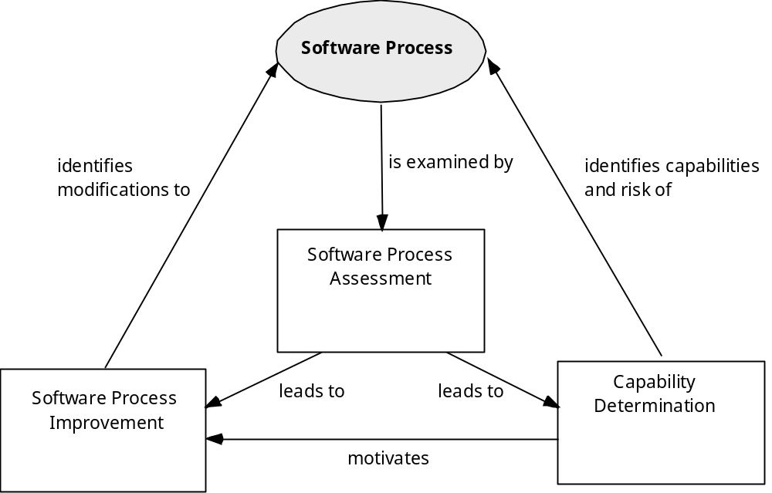
Assessment and Improvement

Slide 33
Personal Software Process (PSP)
Recommends five framework activities:
  Planning
  High-level design
  High-level design review
  Development
  Postmortem
stresses the need for each software engineer to identify errors early and as important, to understand the types of errors

Slide 34
Personal Software Process (PSP)
Planning (activity)
  Isolates requirements
  Develops estimates
    Size
    Resource
    Defects
  Records metrics on worksheets
  Identifies development tasks
  Create project schedule

Slide 35
Personal Software Process (PSP)
High level design
  External specifications are developed
    Component design is created
  Prototypes are built
  All issues are recorded and tracked
High level design review
  Formal verification methods are applied to uncover errors in the design
  Metrics are maintained for all important tasks and work results

Slide 36
Personal Software Process (PSP)
Development
  The component level design is refined and reviewed
  Code is
    Generated
    Reviewed
    Compiled
    Tested
    Metrics are maintained
Postmortem
  Using the measures and metrics collected, the effectiveness of the process is determined

Slide 37
Personal Software Process (PSP)
Stresses the need for each software engineer to identify errors early
To understand the types of errors
Rigorous assessment activity performed on all the work products produced by the software engineer
PSP represents a disciplined, metrics-based approach

Slide 38
Team Software Process (TSP)
Each project is “launched” using a “script” that defines the tasks to be accomplished
Teams are self-directed
Measurement is encouraged
Measures are analyzed with the intent of improving the team process

Slide 39
Team Software Process (TSP)
Objectives
  Build a self-directed project team
    Organizes itself to produce high-quality software
    Plan and track their work
    Establish goals
    Own their process and plans
    Show managers how to coach and motivate their teams
    Accelerate software process improvement

Slide 40
Team Software Process (TSP)
TSP defines framework activities
  Launch
  High level design
  Implementation
  Integration
  Test
  Postmortem
TSP makes use of variety of
  Scripts, forms, and standards that serve to guide team members in their work

Slide 41
Team Software Process (TSP)
TSP – Initial process activity
  Project launch
    Review project objectives with management and agree on and document team goals
    Establish team roles
    Define the team’s development process
    Make quality plan and set quality targets
    Plan for the needed support facilities
    Produce an overall development strategy
    Make detailed plans for each engineer for the next phase
    Merge the individual plans
    Rebalance team workload to achieve overall schedule
    Assess project risks assign tracking responsibility for each key risk

Slide 42
Process Technology
Process technology tools allow a software organization to build an automated model of the common process framework, task sets, umbrella activities
Once an acceptable process has been created, other process technology tools can be used to allocate, monitor, and even control all software engineering tasks

Slide 43
Summary
Software engineering is a discipline that integrates
  Process
  Methods
  Tools
A number of different process models for software engineering have been proposed
  All define
    A set of framework activities
    A collection of tasks that are to be conducted to accomplish each activity
    Work products are produced as a consequence of tasks

Slide 44
Summary
  A set of umbrella activities that span the entire process
  The Capability Maturity Model Integration is a comprehensive process that describes the specific goals, practices, and capabilities that should be present in a mature software process
Personal and team models for the software process have been proposed
  Both emphasize measurement, planning, and self direction as key ingredients for successful software process

